Slide 1
Branch and bound

Slide 2
What is branch and bound algorithm?
Branch and bound is an algorithm design paradigm which is generally used for solving combinatorial optimization problems. These problems are typically exponential in terms of time complexity and may require exploring all possible permutations in worst case. The Branch and Bound Algorithm technique solves these problems relatively quickly
Branch-and-bound is a general technique for improving the searching process by systematically enumerating all candidate solutions and disposing of obviously impossible solutions.

Slide 3
Advantages..
As it finds the minimum path instead of finding the minimum successor so there should not be any repetition.
The time complexity is less compared to other algorithms.

Slide 4
Disadvantages..
The load balancing aspects for Branch and Bound algorithm make it parallelization difficult.
The Branch and Bound algorithm is limited to small size network. In the problem of large networks, where the solution search space grows exponentially with the scale of the network, the approach becomes relatively prohibitive.

Slide 5
Algorithm..
Step 1: PUSH the root node into the stack.
Step 2: If stack is empty, then stop and return failure.
Step 3: If the top node of the stack is a goal node, then stop and return success.
Step 4: Else POP the node from the stack. Process it and find all its successors. Find out the path containing all its successors as well as predecessors and then PUSH the successors which are belonging to the minimum or shortest path.
Step 5: Go to step 5.
Step 6: Exit.

Slide 6
Knapsack problem using branch and bound algorithm
Given two integer arrays val[0..n-1] and wt[0..n-1] that represent values and weights associated with n items respectively.
Find out the maximum value subset of val[] such that sum of the weights of this subset is smaller than or equal to Knapsack capacity W.
You cannot break an item, either pick the complete item, or don’t pick it (0-1 property)

Slide 7
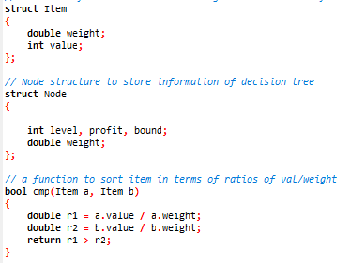
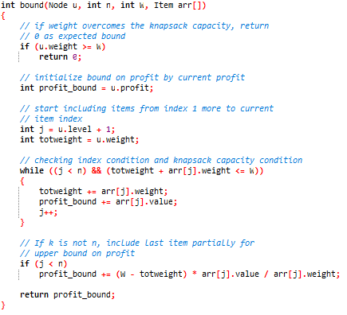
Code--

Slide 8
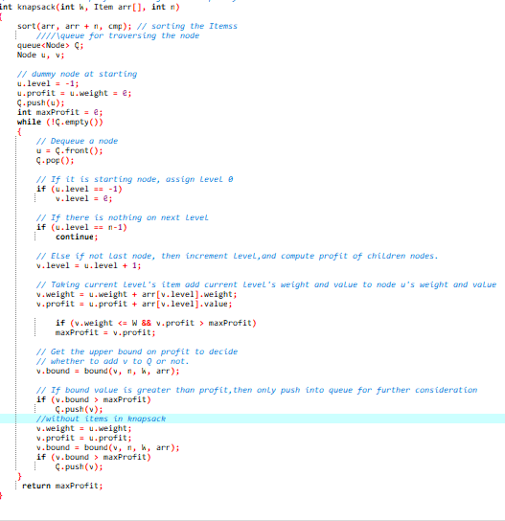

Slide 9
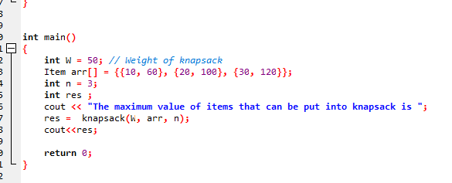

Slide 10
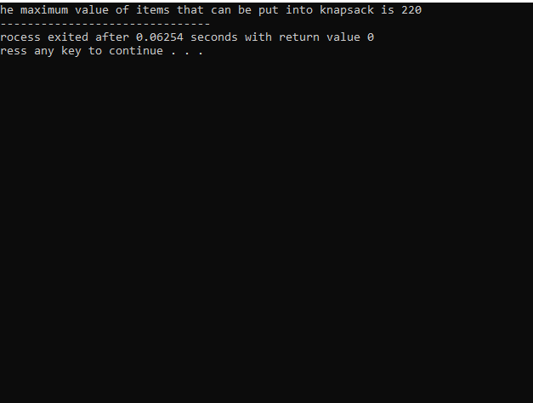
Output--

